Slide 1

Math Tutoring Insights
& DIFFICULTY ANALYZER
Client: Jason – Student, Department of Mathematics
Instructor: Professor Brian Callahan
Team Members: Khoa Hoang & Mujeeb Ali

Slide 2










Problem & Why Now
Students struggle across multiple math topics.
Tutors rely on anecdotal feedback & late exam results.
No centralized, data-driven view of student struggles
Hard to detect at-risk students early.

Slide 3



Sources:
Quizzes, homework, practice tests.
Core tables
Students, Topics, Assessments, Questions, Scores.
Data & Schema
Normalization:
Map questions → topics.
Standardize scores (pct = raw/points).
Build topic-level features (mean, std, % under 60%).

Slide 4





Topic Trouble Index (TTI)
Composite score of difficulty for each topic:
Low average performance
High variance (spread)
High % of low performers
Normalized 0 –100
Ranks topics from hardest → easiest

Slide 5


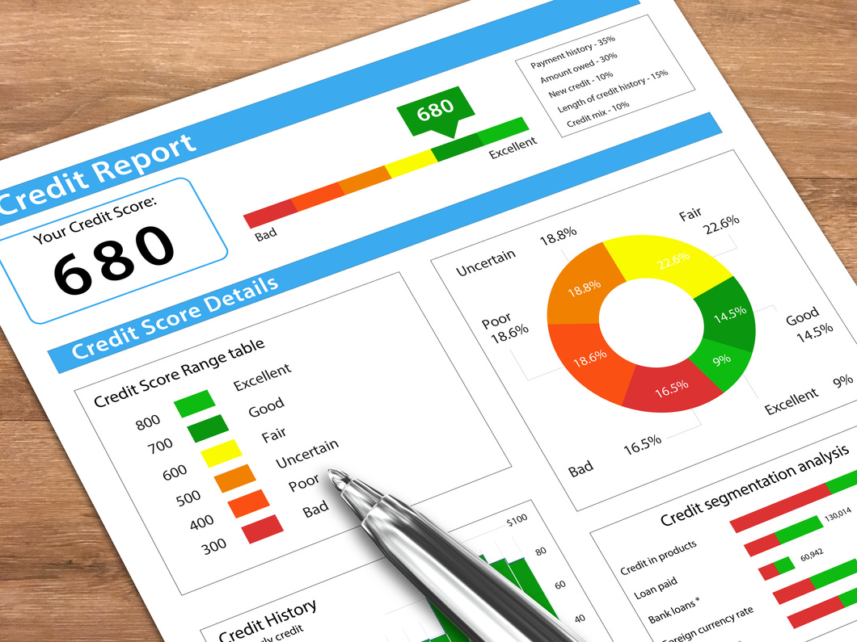

Student Progress Tracker
Track performance over time by topic.
Rolling averages across assessments
Flag “underperforming” if < class mean – 1σ twice in a row.
Helps tutors monitor risk early

Slide 6






Clustering for Group Interventions
Use k-means on student-topic performance vectors.
Group students with similar weaknesses.
Suggest group tutoring sessions for shared problem areas.
Enables more efficient interventions

Slide 7

Predict chance of mastering a topic in the next assessment.
Baseline
Logistic Regression.
Advanced
Mastery Prediction
Random Forest
Features
Recent trends, attempts, time gaps, related topics.
Early alerts for students at risk.

Slide 8





Dashboard & Visualization
Overview
Heatmap
Line chart
Cluster view
Top 5 hardest topics (bar chart).
Student × topic performance.
topic difficulty trend over time.
student groups by weaknesses

Slide 9





Tutor Recommendations
Group
Suggest sessions on topics with high TTI across clusters.
Individual
Highlight 3 riskiest topics + personalized practice.
Data-driven support for tutoring centers.

Slide 10





Faster feedback loops for tutors & students.
Impact & Next Steps
Better targeting of tutoring sessions.
Improved outcomes in difficult topics.
Next: pilot test with anonymized data + ensure fairness & privacy.

Slide 11


THANK YOU
FOR YOUR ATTENTION

